Slide 1

Project: Trips by Distance
SUBMITTED BY : GURTARANJIT KAUR(0814943)
ANKITA(0820948)
NIMRAT SINGH(0810057)
SUBMITTED TO: SAVITA SEHARAWAT

Slide 2
CONTENTS
ABOUT OUR DATASET
METHODOLOGY
DATA DETAIL
IMPORTANT LIBRARIES
DATA CLEANING
CATEGORICAL ATTRIBUTES
DATE AND TIME PART
EXPOLATORY DATASET
DATA DETAIL DICTIONARY
SCATTER PLOT
HISTOGRAM
CORRELATION HEATMAP
TRAIN AND TEST APPROACH
K NEIGHBOUR CLASSIFIER
DECISION TREE CLASSIFIER

Slide 3

Data analysis is carried out at the national, state, and county levels. Furthermore, we investigate the effect of distance on mode choice, demonstrating how consumers prefer different modes of transportation dependent on journey distance. Longer travels are more likely to utilize private vehicles, trains, buses, or airplanes, whereas shorter journeys are more likely to involve, walking , cycling , or local public transit. Understanding these travel patterns and how they affect mobility has several practical applications. This data may be used by urban planners to create more efficient transport networks, prioritize infrastructure development, and adopt policies that encourage sustainable and ecologically friendly travel choices. Furthermore, transport and tourist enterprises can customize their services to individual travel demands depending on distance classifications .Finally , this study sheds light on the complicated link between travel behavior and distance, emphasizing the significance of considering varied travel patterns while developing mobility plans. Stakeholders may collaborate to create a more accessible, efficient, and resilient transportation landscape for the future by recognizing the specific features of journeys by distance.
ABOUT OUR DATASET

Slide 4
Regarding our dataset:
We use the dataset of trips by distance. The purpose of utilizing this information is to identify people who travel away from home or stay at home due to their mobility. Through our new mobility data, the Bureau of Transportation data (BTS) can now answer such queries. The travel statistics are derived from a nationwide panel of mobile device data gathered from various source.
Reference link:
https://catalog.data.gov/dataset/trips-by-distance

Slide 5
METHODOLOGY:
Data processing
EDA
Experimental Design
Model implementation and evaluation
conclusion

Slide 6

DATA DETAIL:
Dataset contains 22 columns about people which explain data about the time how many times they stay at home or go outside from their home within 10 minutes throughout their mobility, even though their record of staying at home or going out of home is calculated weekly and monthly also. This dataset contains the counts of people which move from their home to somewhere in conditions such as- number of people <1 till 500.

Slide 7

IMPORTING USEFULL LIBRARIES: Numpy , Decision tree classifier , Pandas, Matplotlib.

Slide 8

DATA CLEANING:
(EDA) is an approach of analyzing data sets to summarize their main characteristics, often using statistical graphics and other data visualization methods. A statistical model can be used or not, but primarily EDA is for seeing what the data can tell us beyond the formal modeling and thereby contrasts traditional hypothesis testing.

Slide 9
CATEGORICAL ATTRIBUTES

Slide 10

DATE AND TIME PART:
Date Time is a key notion used to describe points in time in computer science and software development. It integrates date and time information into a single data structure, making temporal data handling and comparison simple. Date Time is a programming language and framework that is commonly used to handle time-related tasks such as event scheduling, time zone conversions, and date arithmetic.

Slide 11

EXPOLATORY DATASET:
(EDA) is an approach of analyzing data sets to summarize their main characteristics, often using statistical graphics and other data visualization methods. A statistical model can be used or not, but primarily EDA is for seeing what the data can tell us beyond the formal modeling and thereby contrasts traditional hypothesis testing.

Slide 12

DETAILED DATA DICTIONARY:
In this step, I took one variable at one time to do analysis. First, I assigned the correct data type of each attribute. For numeric attribute I checked five summaries i.e., minimum, maximum, mean, first and third quartile. Next, I decided level and frequency table for each categorical attribute. Then I decided to remove the duplicates, missing values from my dataset.

Slide 13
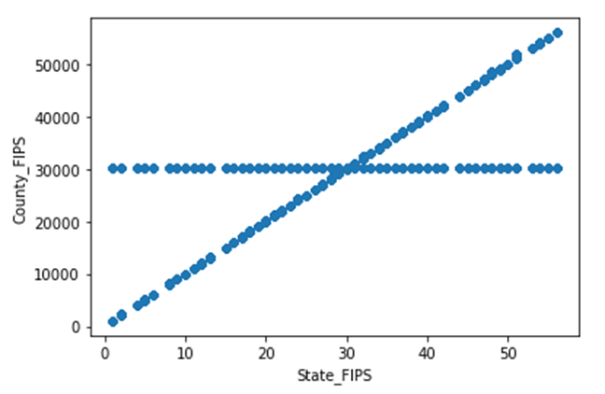
SCATTER PLOT:
As we can see, on y-axis is County_FIPS and on x-axis is State_FIPS which represent the counting of people those move out of their home or stay at home with the gap of 10 minutes .

Slide 14
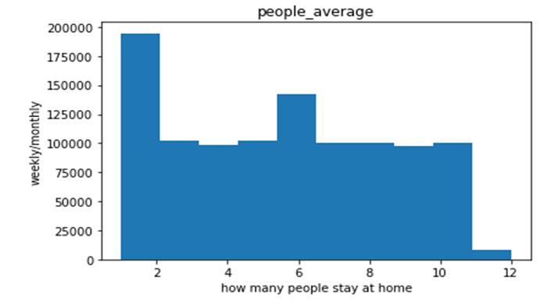
HISTOGRAM OF HOW MANY PEOPLE STAY AT HOME:
In this graph, I can see the plot that calculate weekly/monthly about the people who stay at home within fixed time. Even in this graph x-label is how many people stay at home and y-label is weekly/monthly.

Slide 15
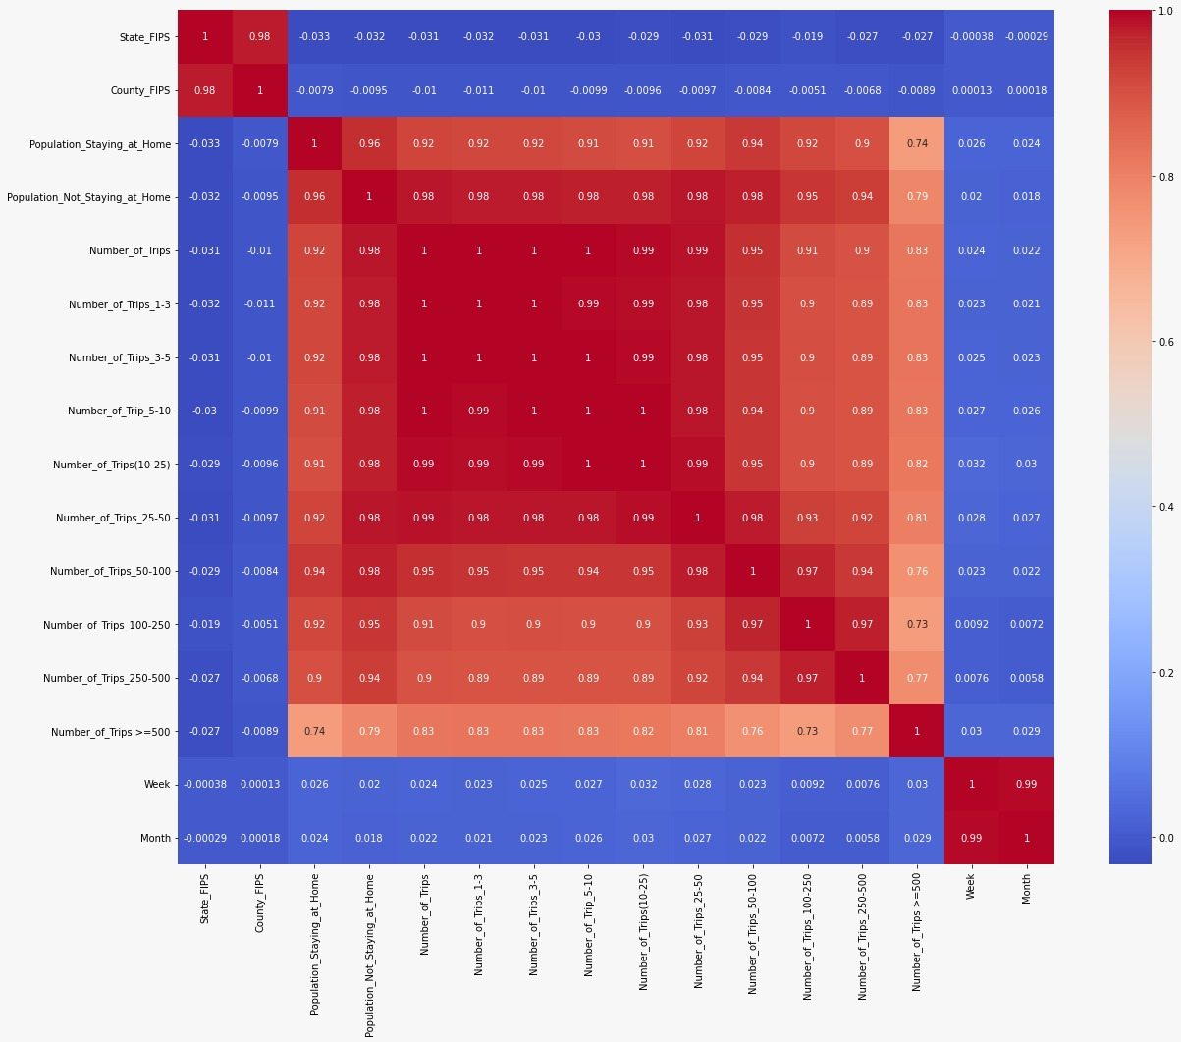
CORRELATION HEATMAP:

Slide 16

A correlation heatmap is a graphical representation used to visualize the correlation between different variables in a dataset. In the context of "trip by distance," it would typically involve examining the relationship between trip-related variables and the distance covered during those trips.

Slide 17

MIN MAX SCALER:
It is a data normalization approach that scales data between 0 and 1. It is a simple technique to normalize data using Python’s min-max functions.
Normalizationis only deal with numerical data, so I decided all category
Variables

Slide 18

EXPERIMENTAL DESIGN

Slide 19

TRAIN AND TEST APPROACH:
In this model, the entire data is randomly divided into training and test set. I divided the information into two parts (training and testing sets). The training set contains 80% of the records in the dataset whereas, the test set contains 20% of the dataset observation.

Slide 20

K NEIGHBOUR CLASSIFIER:
When given a new input data point, the KNN classifier identifies the k nearest data points (neighbors) to the input in the feature space. The class of the input data point is then determined by the majority class among these k neighbors. In other words, if most of the k neighbors belong to a particular class, the input data point is classified into that class.
The choice of the 'k' value is essential in KNN. A smaller 'k' might lead to noisy decisions, while a larger 'k' may cause the boundaries between classes to become too smooth. The optimal value of 'k' depends on the specific dataset and problem at hand and is often found through experimentation or cross-validation.

Slide 21

DECISION TREE CLASSIFIER:
Decision trees can be prone to overfitting, where they memorize the training data and perform poorly on new, unseen data. To mitigate this, you can tune hyperparameters like max_depth, min_samples_split, or min_samples_leaf to control the size and complexity of the tree and improve its generalization ability.
The DecisionTreeClassifier is a powerful and interpretable classification algorithm, making it a popular choice for various machine learning tasks. However, in more complex scenarios, ensemble methods like Random Forests or Gradient Boosting might be preferred, as they can improve performance and reduce overfitting compared to individual decision trees.

Slide 22

ACCURACY:
91.57

